Slide 1
VOIZEE
MINOR PROJECT PRESENTATION BY :-
Srashti Deshmukh
Palak Bisen

Slide 2
TABLE OF CONTENTS
01
04
Project Overview
Feasibility Report
02
05
Project Objective & Scope
Project Proposed Model
03
06
Project Plan
Software Requirements & Specifications

Slide 3
TABLE OF CONTENTS
06
09
Testing Used
Project Estimation And Scheduling
07
10
UML Diagrams
Screen Shots Of Project
08
11
Coding Of Main Module
Limitations & Future Work
12
Bibliography

Slide 4
Overview
VOIZEE
"The key is in not spending time, but in investing it.“
-- Stephen R. Covey
The use of speech to text services is growing, Users rely on speech to text services for many different reasons.
The main benefits users are experiencing are time & cost savings.
On the other hand ,speech-to-text conversion , aims at providing benefits for the, People who suffer from low vision, sight and visual impairment , so that they can also interact with the computer and utilize the facilities of the computer.
Keeping these things in mind we made a web app “VOIZEE “which provides both the facilities. “VOIZEE” is a voice controlled notes app which also has a feature of text to speech converter in it.

Slide 5
Project Objective
SECURE
ACCESSIBLE
FAST AND RELIABLE
Mercury is the closest planet to the Sun
Despite being red, Mars is a cold place, not hot
Neptune is the farthest planet from the Sun

Slide 6
MAJOR REQUIREMENTS
IMAGES
USER EXPERIENCE
INFORMATION
Despite being red, Mars is a cold place, not hot. It’s full of iron oxide dust
Venus has a beautiful name and is the second planet from the Sun
Mercury is the closest planet to the Sun and the smallest in our Solar System

Slide 7
Feasibility Report
Innovativeness & Usefulness
Competitive Advantages
Ease of communication – No more illegible handwriting & Quick document turnaround.
Time saved with increased efficiency
It facilitates education as it enables user to make their own notes and download them.
Helpful for people with learning or reading disorder.
Speed and Ease of Use
The risk of losing of data during fetching process is minimal, hence data inconsistency is not possible
Speech-text and text-speech both in one frame.
Data redundancy is not possible

Slide 8
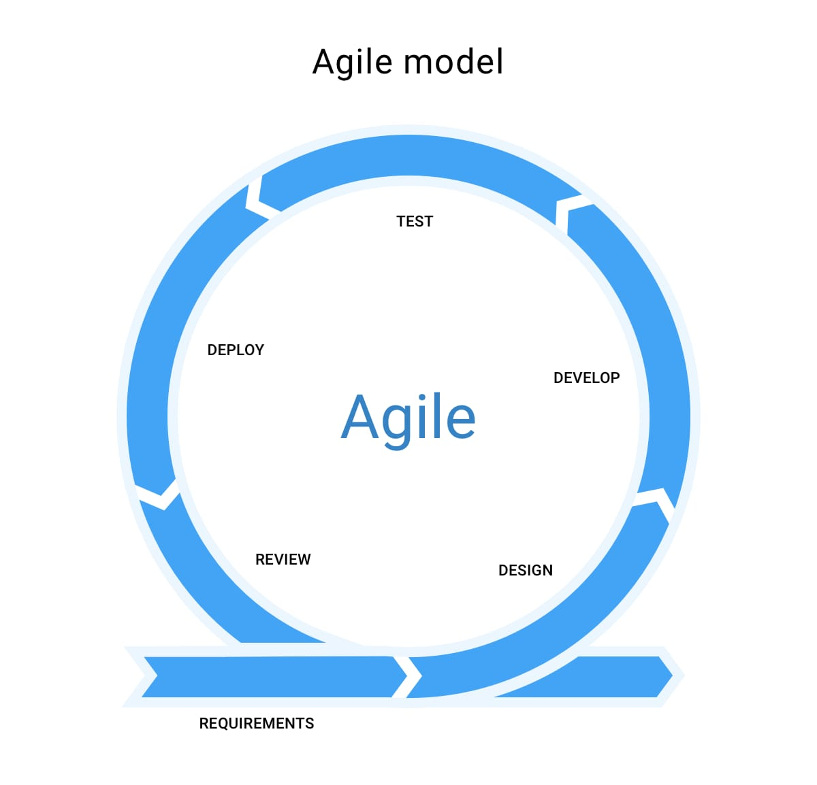
Project Proposed Model
The meaning of Agile is swift or versatile. "Agile process model" is based on iterative development.
Agile methods break tasks into smaller iterations, or parts do not directly involve long term planning.
Each iteration is considered as a short time "frame" in the Agile process model, which typically lasts from one to four weeks.
The division of the entire project into smaller parts helps to minimize the project risk and to reduce the overall project delivery time requirements.
Unknown Author is licensed under CC B

Slide 9
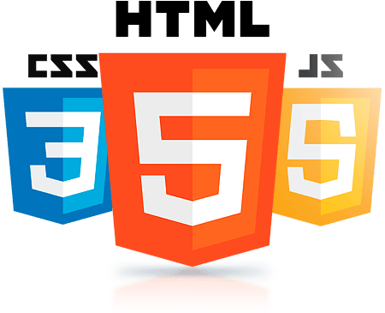
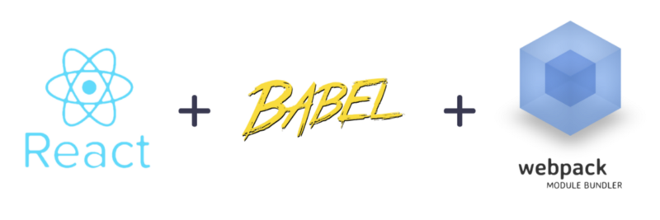
Project Plan
The project is mainly created with React 16.6.3, html, css and JS.
It also uses Webpack 4.3.0 as a module bundler.
We have also used session storage allow you to save key/value pairs in a web browser
We have used The speech recognition API here.
For compiling we have used Babel 7 and for testing purpose Jest is used.

Slide 10
Project Estimation & Scheduling
It took us around 24 days to complete our project that involved following phases :
Idea Generation
Project Planning
Coding & Designing
Monitering and control

Slide 11
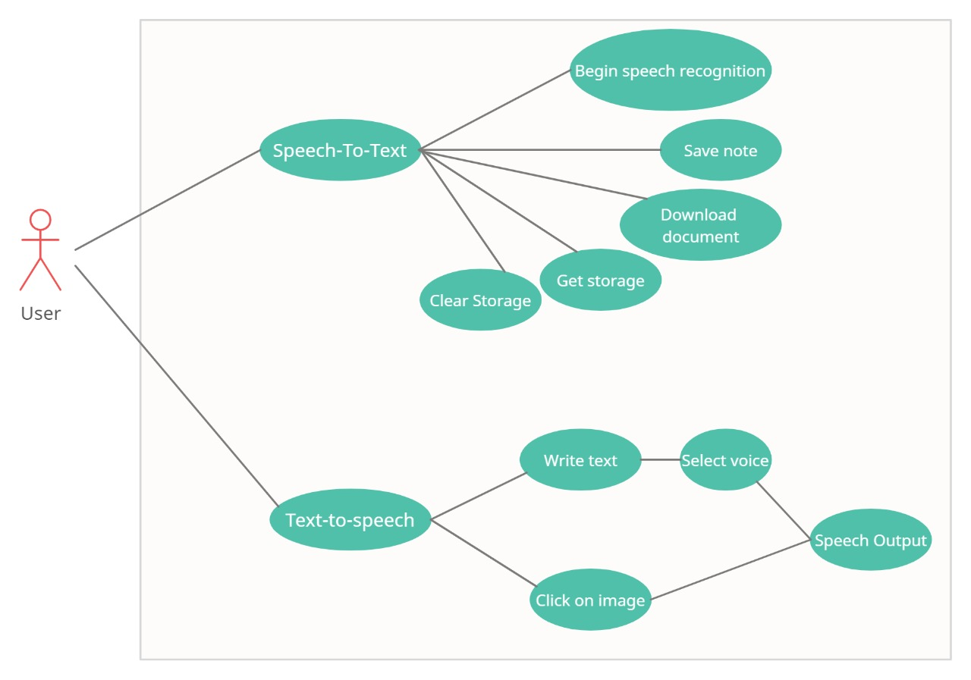
Use Case Diagram

Slide 12
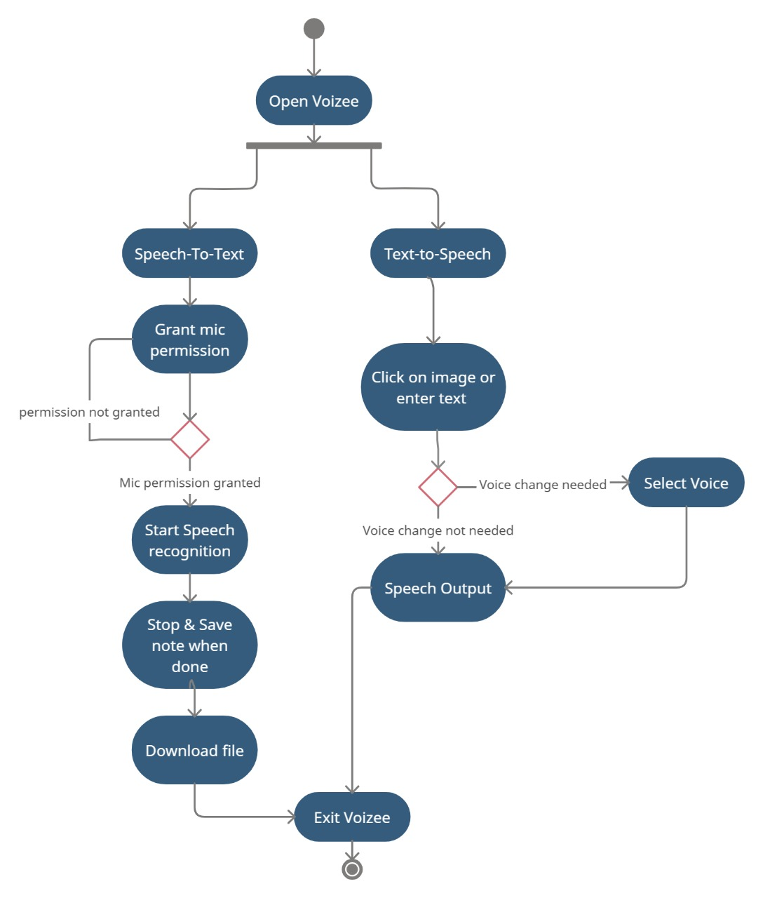
Activity Diagram

Slide 13
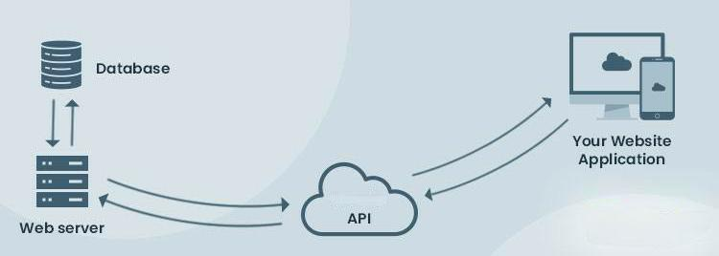
Data Flow Diagram

Slide 14
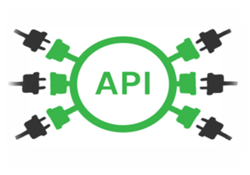
Coding Of Main Module
What is an API?
API stands for Application Programming Interface..
In basic terms, APIs are a set of functions and procedures that allow for the creation of applications that access data and features of other applications, services or operating services.
A programmer can make use of various API tools to make its program easier and simpler.
Unknown Author is licensed under CC B

Slide 15
Web Speech Recognition API
In this project we have used Speech Recognition Using the Web Speech API in JavaScript.
The Web Speech API is used to incorporate voice data into web apps.
This API allows fine control and flexibility over the speech recognition capabilities .
It is super easy to recognize speech in a browser using JavaScript and then getting the text from the speech to use as user input.
Unknown Author is licensed under CC B

Slide 16
React + webpack4+ babel
Essentially, converting any es5+ code to its browser compatible version is a two step process , Transpiling and bundling.
Webpack-
Building is the process of combining all the code across your project and putting it in a single file. Webpack does this for you.
Babel-
Transpiling is the process of converting modern Javascript code to a form that is understood by even older browsers. Babel takes care of this. Babel also has various presets which allow for Transpiling different versions.
Unknown Author is licensed under CC B

Slide 17

Testing Used
The expect() function gives us a number of matchers that let us validate different things, such as toBe()
Building a well-functioning application requires good testing
In this project we have used Jest for testing
What is jest?
Jest —
A testing framework maintained by Facebook to test our React components.
Jest is one of the best tools available for testing React applications.
In our tests we check that values meet certain conditions. The expect function gives us a number of matchers that let us validate different things.
Unknown Author is licensed under CC B

Slide 18
SCREEN SHOTS OF PROJECT

Slide 19
Insert your multimedia content here

Slide 20
Insert your multimedia content here

Slide 21
Insert your multimedia content here

Slide 22
Insert your multimedia content here

Slide 23
Limitations & Future Scope
limitations

Slide 24
Limitations & Future Scope
Future scope

Slide 25
Bibliography
https://reactjs.org/
https://jestjs.io/
https://webpack.js.org/
https://babeljs.io/
https://en.wikipedia.org

Slide 26
Demonstration
HEADER
TEXT
SLIDER
ICONS

Slide 27



THE TEAM
Srashti deshmukh
Palak bisen
JIMMY DOE
You can replace the image on the screen with your own
You can replace the image on the screen with your own
You can replace the image on the screen with your own

Slide 28
THANKS!

Slide 29
OUR GOALS
EXPANSION
POSITIONING
USABILITY
Neptune is the fourth-largest planet in our Solar System
Venus has a beautiful name and is the second planet from the Sun
Despite being red, Mars is a cold place, not hot. It’s full of iron oxide dust

Slide 30
PROJECT STAGES
STEP 2
STEP 1
STEP 3
Venus has a beautiful name and is the second planet from the Sun
Despite being red, Mars is a cold place, not hot. It’s full of iron oxide dust
Saturn is a gas giant, composed mostly of hydrogen and helium

Slide 31
OUR PARTNERS
MARS
VENUS
MERCURY
Mercury is the closest planet to the Sun and the smallest one in our Solar System
Despite being red, Mars is a cold place, not hot. It’s full of iron oxide dust
Venus has a beautiful name and is the second planet from the Sun

